Slide 1


Poem
Appreciation & Writing
诗歌欣赏与写作

Slide 2
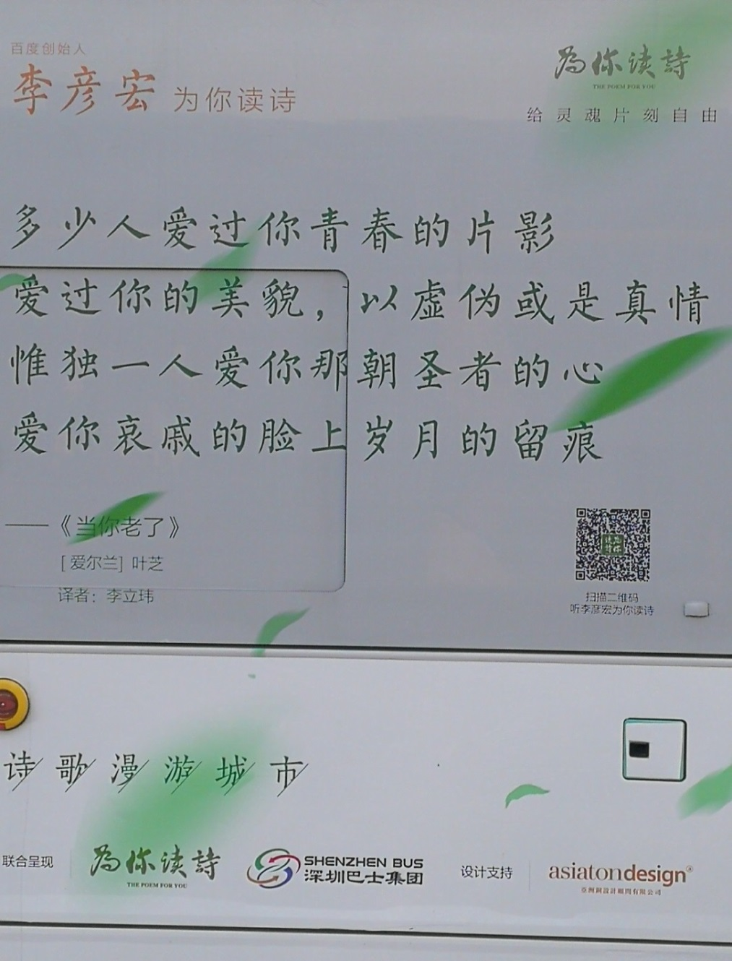

Slide 3
Analysis：
When You Are Old (1)
----WILLIAM BUTLER YEATS
When you are old and gray and full of sleep
And nodding by the fire, take down this book,
当你老了，白发苍苍，睡意朦胧， 在炉前打盹，请取下这本诗篇， And slowly read, and dream of the soft look Your eyes had once, and of their shadows deep；
慢慢吟诵，梦见你当年的双眼 那柔美的光芒与青幽的晕影；
Notes:
3

Slide 4
Analysis：
When You Are Old (2)
----WILLIAM BUTLER YEATS
How many loved your moments of glad grace, And loved your beauty with love false or true；多少人爱你青春欢畅的时辰 爱慕你的美丽，假意或真心， But one man loved the pilgrim soul in you, And loved the sorrows of your changing face;只有一个人爱你那朝圣者的灵魂， 爱你衰老了脸上的痛苦的皱纹。

Slide 5
When you are old
When you are old and grey and full of sleep,
And nodding by the fire, take down this book,
And slowly read, and dream of the soft look,
Your eyes had once, and of their shadows deep;
How many loved your moments of glad grace,
And loved your beauty with love false or true,
But one man loved the pilgrim soul in you,
And loved the sorrows of your changing face;
And bending down beside the glowing bars,
Murmur, a little sadly, how love fled,
And paced upon the mountains overhead,
And hid his face amid a crowd of stars.
a
b
b
a
c
d
d
c
e
f
f
e

Slide 6

Sonnet 18
William Shakespeare
Shall I compare thee to a summer’s day,
Thou art more lovely and temperate.

Slide 7
Shall I compare thee to a summer’s day?
Thou art more lovely and more temperate：
Rough winds do shake the darling buds of May,
And Summer’s lease hath all too short a date:
Sometime too hot the eye of heaven shines,
And often is his gold complexion dimmed;
And every fair from fair sometime declines,
By chance, or nature’s changing course untrimmed;
But thy eternal summer shall not fade,
Nor lose possession of that fair thou ow’st,
Nor shall Death brag thou wand’rest in his shade,
When in eternal lines to time thou grow’st,
So long as men can breathe or eyes can see,
So long live this, and this gives life to thee.
a
b
a
b
c
d
c
a
a
d
a
a
e
f
f
e
g
g

Slide 8
Shall I /compare thee /to a summer’s day?
Thou art more lovely /and more temperate：
Rough winds /do shake /the darling buds of May,
And Summer’s lease /hath all too short a date:
Sometime too hot/ the eye of heaven shines,
And often is/ his gold complexion dimmed;
And every fair/ from fair sometime /declines,
By chance, /or nature’s changing course/ untrimmed;
But thy eternal summer/ shall not fade,
Nor lose possession /of that fair thou ow’st,
Nor shall Death /brag thou wand’rest/ in his shade,
When in eternal lines /to time thou grow’st,
So long as men can breathe /or eyes can see,
So long live this, and this/ gives life to thee.

Slide 9
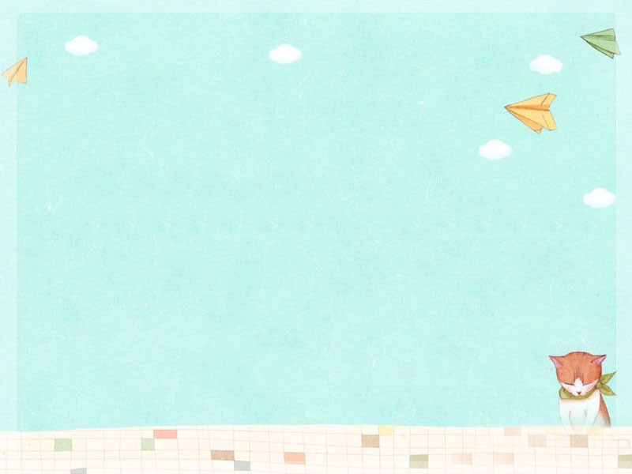
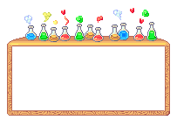

Cinquain
A style of five-line poem.
Cinquain is a five-line poem, which can give a clear picture and create a special feeling using a few words.

Slide 10

Appreciating Time
Brother
Beautiful, athletic
Teasing, shouting, laughing
Friend and enemy too
Mine
Summer
Sleepy, salty
Drying, drooping, dreading
Week in, week out
Endless

Slide 11
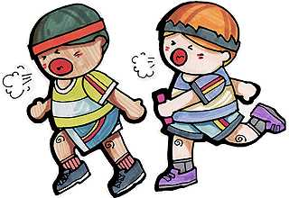
Structures of Cinquain
Brother
Beautiful ,athletic
Teasing, shouting ,laughing
Friend and enemy too
mine
topic
---one word
---two adjs
Describe the topic
---three –ing verbs
Express action
---four words
Express the feelings or describe the subject
---one word
rename the topic ;conclusion

Slide 12
Writing Time
Try to write a cinquain together.
Look at some pictures and think about
what you want to write about.

Slide 13

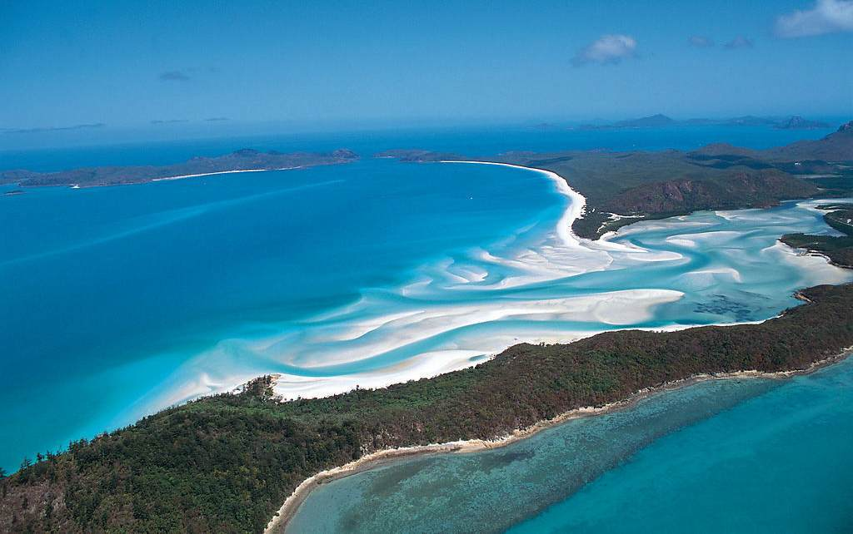
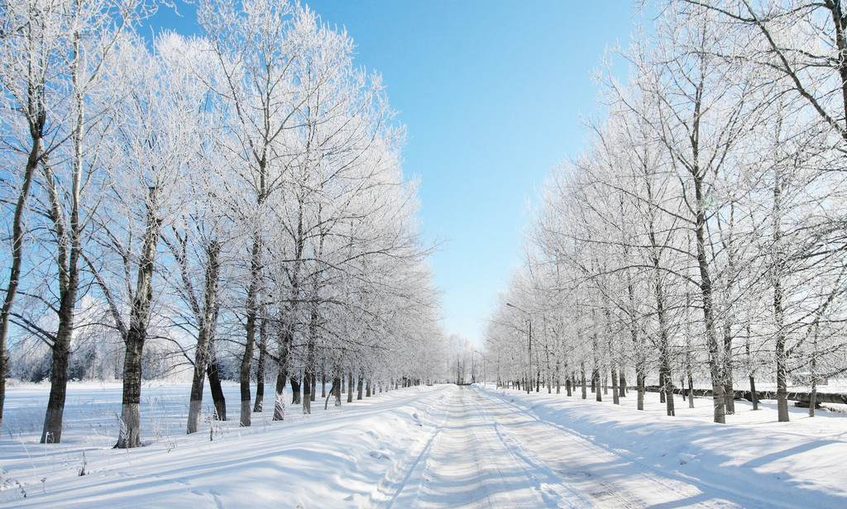
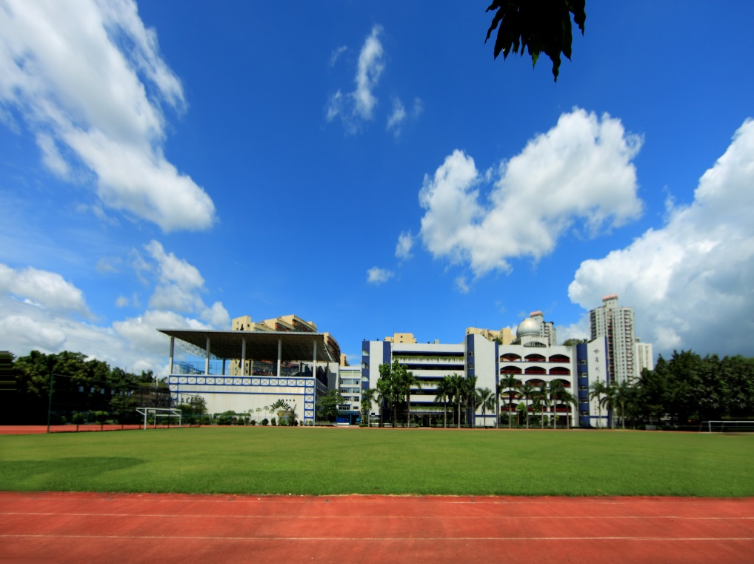
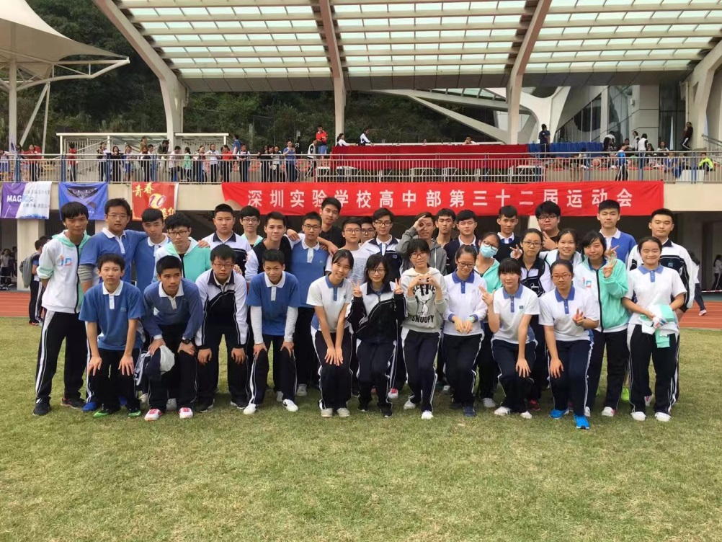
sea
winter
SZSY
Class 10

Slide 14
Show Time

Slide 15
List poems
Poems that list things
List poems have a flexible line length and repeated phrases which give both a pattern and a rhythm to the poem.

Slide 16

Our first football match
We would have won…
if Jack had just scored that goal,
if we’d had just a few more minutes,
if we had trained harder,
if Ben had passed the ball to Joe,
if we’d had thousands of fans screaming,
if I hadn’t taken my eye off the ball,
if we hadn’t stayed up so late the night before,
if we hadn’t taken it easy,
if we hadn’t run out of energy,
We would have won…
if we’ve been better!

Slide 17
Version 1:
I would have done better in the exam,
if I had____________________________,
if I had____________________________,
…
…
Version 2:
If I were a boy/girl
I would____________________________,
I would____________________________,
…
…
Version 3:
If I were a big tree, I would grow so tall that I’d touch the sky.
If I were a butterfly, I would……
If I were a …… , I would ……
…
…

Slide 18
Thank you!
Good bye!

